Slide 1
Paxos Made Simple
Leslie Lamport
Anshi Agarwal
Kathleen Blanck

Slide 2
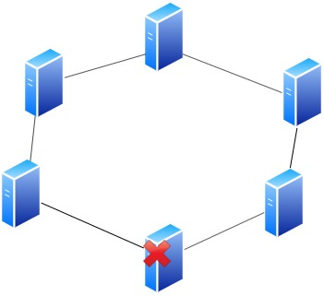
Introduction
Notes:
Distributed systems are implemented for high availability and scalability using many commodity machines. Such machines are not reliable entities and these come up and go down quite often. In such systems, there is often a need to agree upon “something” i.e. to have consensus. “Something” here depends on the context.

Slide 3
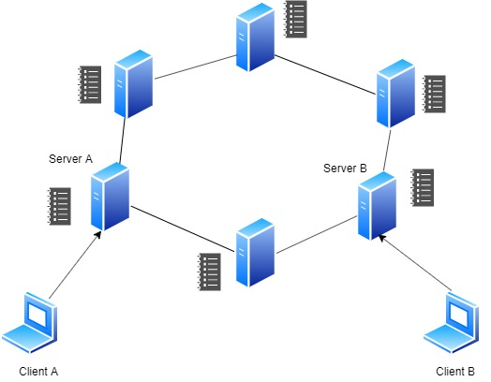
Consensus Problem
Notes:
In a digitized system(like bank) operating in many branches and doing many transactions, one needs to have a consistent view of all the accounts. At a given point, there is a consistent state of the bank, which in turn translates to the the correct amounts in all bank accounts. One way to achieve this is to maintain an ordered log of operations across a certain number of server nodes(One server node is not sufficient because it can go down, thus impacting availability and scalability). The consistent view of the ordered log on these server nodes ensures that there is a consistent view of of all the accounts in the system: Basically bank becomes a state machine which takes in as input the current state of all the accounts and ordered log of operations that adjust the account to reflect the newest transactions. From here on, we will only worry about these server nodes that need to maintain the consistency of the ordered log.
So each server node keeps its own log and nodes can communicate with each other to establish the order, as users deposit or withdraw money from their accounts. So with this, a client can connect to one server and another client can connect to a different server and still get the same view of the bank’s current state i.e. account values. Also, keep in mind that failures are non-byzantine i.e. server nodes in the bank are not incentivized to collude and maliciously alter the log. (A side note here is that bitcoin network also needs to solve the similar problem, but the failures can be byzantine due to the trust-less nature of the nodes)
Now let’s see how can all nodes can agree on a consistent view of the log. A simpler problem of this is first to figure out how nodes can agree on a single unalterable value i.e. Transaction X did Y. (Here transaction X is the index into the log. Let’s ignore that for now) and Y is the value that the network of nodes need to agree on and commit at index X in the log on all nodes. Let’s call this basic Paxos. Once we have established this, we can use it as a building block to achieve the distributed ordered log.

Slide 4
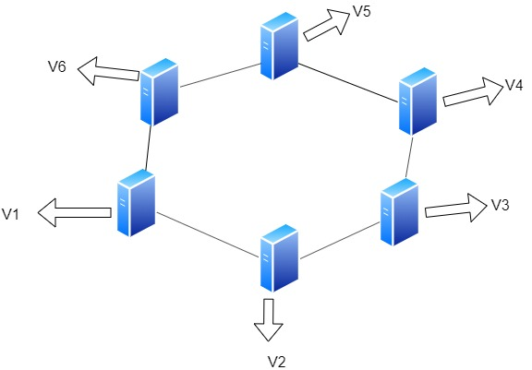
Requirements of Consensus Algorithm
Proposed value should be chosen
Single value is chosen
Processes are only told values that have been chosen
Notes:
A consensus algorithm
ensures that a single one among the proposed values is chosen. If
no value is proposed, then no value should be chosen. If a value has been
chosen, then processes should be able to learn the chosen value.
We won’t try to specify precise liveness requirements. However, the goal is
to ensure that some proposed value is eventually chosen and, if a value has
been chosen, then a process can eventually learn the value.

Slide 5
Roles in Consensus Algorithm
Three major roles:
Proposer
Acceptor
Learner
Notes:
Synod consensus algorithm https://distributedthoughts.com/2013/09/30/understanding-paxos-part-2/
a) all the nodes participating have the same output value, b) the output value is proposed by some node (not just an arbitrary value), and c) if enough nodes can communicate with each other, eventually the algorithm will finish
We let the three roles in the consensus algorithm be performed by three
classes of agents: proposers, acceptors, and learners. In an implementation,
a single process may act as more than one agent, but the mapping from
agents to processes does not concern us here.
Assume that agents can communicate with one another by sending messages.
We use the customary asynchronous, non-Byzantine model, in which:
Agents operate at arbitrary speed, may fail by stopping, and may
restart. Since all agents may fail after a value is chosen and then
restart, a solution is impossible unless some information can be remembered
by an agent that has failed and restarted.
² Messages can take arbitrarily long to be delivered, can be duplicated,
and can be lost, but they are not corrupted.

Slide 6
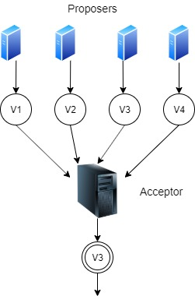
Choosing a Value : Single Acceptor Agent
Notes:
single acceptor agent. A proposer
sends a proposal to the acceptor, who chooses the first proposed value
that it receives. Although simple, this solution is unsatisfactory because the
failure of the acceptor makes any further progress impossible.

Slide 7
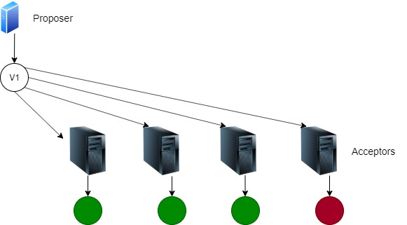
Choosing a Value : Multiple Acceptor Agents
Notes:
Instead of a single acceptor,
let’s use multiple acceptor agents. A proposer sends a proposed value to a
set of acceptors. An acceptor may accept the proposed value. The value is
chosen when a large enough set of acceptors have accepted it. How large is
large enough? To ensure that only a single value is chosen, we can let a large
enough set consist of any majority of the agents. Because any two majorities
have at least one acceptor in common, this works if an acceptor can accept
at most one value. (There is an obvious generalization of a majority that
has been observed in numerous papers, apparently starting with [3].)
In the absence of failure or message loss, we want a value to be chosen
even if only one value is proposed by a single proposer

Slide 8
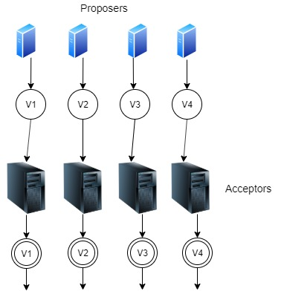
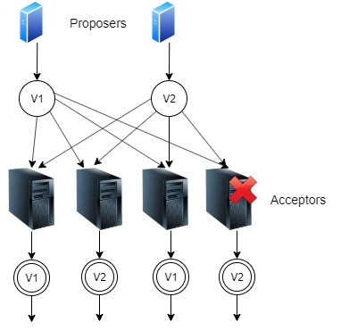
Requirements
P1. An acceptor must accept the first proposal that it receives.
Notes:
Several values could be proposed by
different proposers at about the same time, leading to a situation in which
every acceptor has accepted a value, but no single value is accepted by a
majority of them. Even with just two proposed values, if each is accepted by
about half the acceptors, failure of a single acceptor could make it impossible
to learn which of the values was chosen.
P1 and the requirement that a value is chosen only when it is accepted
by a majority of acceptors imply that an acceptor must be allowed to accept
more than one proposal.

Slide 9
Requirements
P2. If a proposal with value v is chosen, then every higher-numbered proposal that is chosen has value v.
<proposal number, value>
P2ª . If a proposal with value v is chosen, then every higher-numbered proposal accepted by any acceptor has value v.
Notes:
We keep track of the different proposals that an
acceptor may accept by assigning a (natural) number to each proposal, so a
proposal consists of a proposal number and a value. To prevent confusion,
we require that different proposals have different numbers.
How this is
achieved depends on the implementation, so for now we just assume it. A
value is chosen when a single proposal with that value has been accepted by
a majority of the acceptors. In that case, we say that the proposal (as well
as its value) has been chosen.
We can allow multiple proposals to be chosen, but we must guarantee
that all chosen proposals have the same value.
Since numbers are totally ordered, condition P2 guarantees the crucial safety
property that only a single value is chosen.
To be chosen, a proposal must be accepted by at least one acceptor.

Slide 10
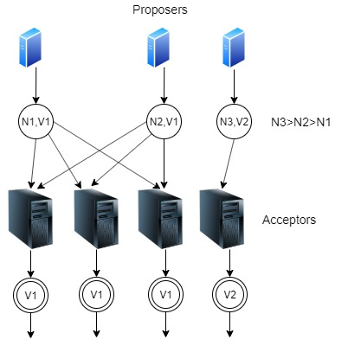
Shortcoming of P2ª
Notes:
We still maintain P1 to ensure that some proposal is chosen. Because communication
is asynchronous, a proposal could be chosen with some particular
acceptor c never having received any proposal. Suppose a new proposer
“wakes up” and issues a higher-numbered proposal with a different value.
P1 requires c to accept this proposal, violating P2a . Maintaining both P1
and P2a requires strengthening P2a to:

Slide 11
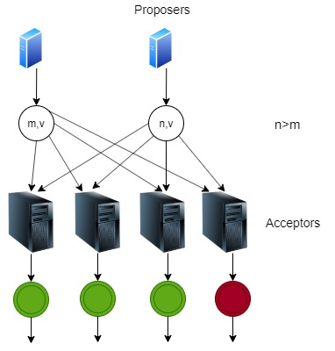
Requirements
P2^{b} . If a proposal with value v is chosen, then every higher-numbered proposal issued by any proposer has value v.
P2^{b} ⇒ P2ª⇒ P2
Notes:
Since a proposal must be issued by a proposer before it can be accepted by
an acceptor, P2b implies P2a , which in turn implies P2.

Slide 12
Requirements
P2^{c} . For any v and n, if a proposal with value v and number n is issued, then there is a set S consisting of a majority of acceptors such that either
(a) no acceptor in S has accepted any proposal numbered less than n, or
(b) v is the value of the highest-numbered proposal among all proposals numbered less than n accepted by the acceptors in S.
Notes:
Since any set S consisting of a majority of acceptors contains at least one
member of C, we can conclude that a proposal numbered n has value v by
ensuring that the following invariant is maintained:
We can therefore satisfy P2b by maintaining the invariance of P2c.
To maintain the invariance of P2c, a proposer that wants to issue a proposal
numbered n must learn the highest-numbered proposal with number
less than n, if any, that has been or will be accepted by each acceptor in
some majority of acceptors. Learning about proposals already accepted is
easy enough; predicting future acceptances is hard. Instead of trying to predict
the future, the proposer controls it by extracting a promise that there
won’t be any such acceptances. In other words, the proposer requests that
the acceptors not accept any more proposals numbered less than n.

Slide 13
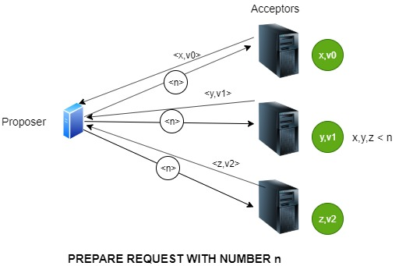
Proposal Algorithm
Notes:
A proposer chooses a new proposal number n and sends a request to
each member of some set of acceptors, asking it to respond with:
(a) A promise never again to accept a proposal numbered less than
n, and
(b) The proposal with the highest number less than n that it has
accepted, if any.
I will call such a request a prepare request with number n.
If the proposer receives the requested responses from a majority of
the acceptors, then it can issue a proposal with number n and value
v, where v is the value of the highest-numbered proposal among the
responses, or is any value selected by the proposer if the responders
reported no proposals.

Slide 14
Requirements
P1ª. An acceptor can accept a proposal numbered n if and only if it has not responded to a prepare request having a number greater than n.
1
1
5
1
5
4
1
1
1
1
5
5
5
5
5
5
5
5
Notes:
A proposer issues a proposal by sending, to some set of acceptors, a request
that the proposal be accepted. (This need not be the same set of acceptors
that responded to the initial requests.) Let’s call this an accept request.
This describes a proposer’s algorithm. What about an acceptor? It can
receive two kinds of requests from proposers: prepare requests and accept
requests. An acceptor can ignore any request without compromising safety.
It can
always respond to a prepare request. It can respond to an accept request,
accepting the proposal, iff it has not promised not to.
We now have a complete algorithm for choosing a value that satisfies the
required safety properties—assuming unique proposal numbers.
Suppose an acceptor receives a prepare request numbered n, but it has
already responded to a prepare request numbered greater than n, thereby
promising not to accept any new proposal numbered n. There is then no
reason for the acceptor to respond to the new prepare request, since it will
not accept the proposal numbered n that the proposer wants to issue. So
we have the acceptor ignore such a prepare request. We also have it ignore
a prepare request for a proposal it has already accepted.
With this optimization, an acceptor needs to remember only the highestnumbered
proposal that it has ever accepted and the number of the highestnumbered
prepare request to which it has responded.
Because P2c must
be kept invariant regardless of failures, an acceptor must remember this
information even if it fails and then restarts.

Slide 15
Dual Phase Algorithm
Phase 1:
Proposer selects a proposal n and sends a prepare request for n to a majority of acceptors
Acceptor promises not to accept any proposals less than or equal to n (if n is the highest proposal it has received)
Notes:
https://distributedthoughts.com/2013/09/30/understanding-paxos-part-2/

Slide 16
Dual Phase Algorithm
Phase 1:
Proposer selects a proposal n and sends a prepare request for n to a majority of acceptors
Acceptor promises not to accept any proposals less than or equal to n (if n is the highest proposal it has received)
Phase 2:
If a majority of acceptors responds with a promise, it sends an accept request for proposal n with value v
An acceptor will accept the proposal n if it has not received any higher numbered prepare requests
Notes:
But why couldn’t we just have perpetually increasing proposals??

Slide 17
Distinguished Proposer
Distinguished proposer, or leader, is the only server to send proposals to acceptors
The validity of the leader is checked at given time intervals
If the leader fails, a new election cycle is run to find a new distinguished proposer

Slide 18
Dual Phase Algorithm
Phase 1:
Proposer selects a proposal n and sends a prepare request for n to a majority of acceptors
Acceptor promises not to accept any proposals less than or equal to n (if n is the highest proposal it has received)
Phase 2:
If a majority of acceptors responds with a promise, it sends an accept request for proposal n with value v
An acceptor will accept the proposal n if it has not received any higher numbered prepare requests

Slide 19
We have an accepted proposal!
What next?
5
5
5
5
5

Slide 20
Proposal -> Acceptance -> Learning
Distinguished Learner: a server used to communicate an accepted value from acceptors to all other learners
No Distinguished Learner:
Immediately informed
All acceptors send n to all learners, meaning higher complexity
Distinguished Learner:
Delay as learner receives message then distributes
Lower complexity
Higher chance of lost messages
Distinguished Learner Set:
Same delay as single
Increase in complexity
Much greater reliability

Slide 21
Implementation in a Network
Each process is a proposer, acceptor, and learner
In case of failure, new leader was a learner and has complete log
Memory must be stable to maintain information during failures
Commits are made to storage before responses are sent
Disjoint set of numbers for different proposers
Notes:
In its consensus
algorithm, each process plays the role of proposer, acceptor, and learner.
The algorithm chooses a leader, which plays the roles of the distinguished
proposer and the distinguished learner.
describe the mechanism for guaranteeing that no
two proposals are ever issued with the same number. Different proposers
choose their numbers from disjoint sets of numbers, so two different proposers
never issue a proposal with the same number. Each proposer remembers
(in stable storage) the highest-numbered proposal it has tried to issue,
and begins phase 1 with a higher proposal number than any it has already
used.

Slide 22
Paxos Algorithm as a State Machine
Paxos is implemented on every server as a state machine
Each server is a deterministic state machine that takes client commands as input to progress to the next state
Each server should progress in the same way with the same input
A
B
...
i=1
i=2
i=3
i=n-1
i=n
Notes:
A simple way to implement a distributed system is as a collection of clients
that issue commands to a central server. The server can be described as
a deterministic state machine that performs client commands in some sequence.
The state machine has a current state; it performs a step by taking
as input a command and producing an output and a new state. For example,
the clients of a distributed banking system might be tellers, and
the state-machine state might consist of the account balances of all users.
A withdrawal would be performed by executing a state machine command
that decreases an account’s balance if and only if the balance is greater than
the amount withdrawn, producing as output the old and new balances.
An implementation that uses a single central server fails if that server
fails. We therefore instead use a collection of servers, each one independently
implementing the state machine. Because the state machine is deterministic,
all the servers will produce the same sequences of states and outputs if they
all execute the same sequence of commands. A client issuing a command
can then use the output generated for it by any server
To guarantee that all servers execute the same sequence of state machine
commands, we implement a sequence of separate instances of the Paxos
consensus algorithm, the value chosen by the ith instance being the i th state
machine command in the sequence.

Slide 23
Paxos Algorithm as a State Machine
Single server is elected as distinguished proposer
Distinguished proposer decides sequence of commands
Notes:
use the same sets of agents.
In normal operation, a single server is elected to be the leader, which
acts as the distinguished proposer (the only one that tries to issue proposals)
in all instances of the consensus algorithm. Clients send commands to the
leader, who decides where in the sequence each command should appear.
If the leader decides that a certain client command should be the 135th
command, it tries to have that command chosen as the value of the 135th
instance of the consensus algorithm. It will usually succeed. It might fail
because of failures, or because another server also believes itself to be the
leader and has a different idea of what the 135th command should be. But
the consensus algorithm ensures that at most one command can be chosen
as the 135th one.
Since in the algorithm, the value to be proposed is not chosen until phase 2. Recall that,
after completing phase 1 of the proposer’s algorithm, either the value to be
proposed is determined or else the proposer is free to propose any value.

Slide 24
What happens when leader fails?
Phase 1 execution for instances 5-7 and all instances greater than 9
Execute Phase 2 for instance 5 and 10, thereby choosing command 5 and 10
Cannot execute command 8-10
Notes:
I consider
what happens when the previous leader has just failed and a new leader has
been selected.
Suppose that the outcome of these executions
determine the value to be proposed in instances 135 and 140, but
leaves the proposed value unconstrained in all other instances.
The leader
then executes phase 2 for instances 135 and 140, thereby choosing commands
135 and 140.
The leader, as well as any other server that learns all the commands
the leader knows, can now execute commands 1–135. However, it can’t
execute commands 138–140, which it also knows, because commands 136
and 137 have yet to be chosen.

Slide 25
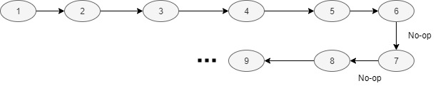
Solution : Propose No-op
The No-Op will maintain the machine’s state and look for previously accepted commands
Notes:
The leader could take the next two commands
requested by clients to be commands 136 and 137. Instead, we let it fill the
gap immediately by proposing, as commands 136 and 137, a special “noop”
command that leaves the state unchanged. (It does this by executing
phase 2 of instances 136 and 137 of the consensus algorithm.)
Once these no-op commands have been chosen, commands 138–140 can be executed.

Slide 26
Why the gap?
Leader can propose command i+1 before it learns acceptance of i
Leader can fail, leaving a gap in the sequence of chosen commands
Can propose i+1 to i+k after commands 1...i are chosen, leaving a gap of k commands
Notes:
The leader can propose command 142 before it learns that its proposed
command 141 has been chosen. It’s possible for all the messages it sent
in proposing command 141 to be lost, and for command 142 to be chosen
before any other server has learned what the leader proposed as command
141. When the leader fails to receive the expected response to its phase 2
messages in instance 141, it will retransmit those messages. If all goes well,
its proposed command will be chosen. However, it could fail first, leaving a
gap in the sequence of chosen commands. In general, suppose a leader can
get ® commands ahead—that is, it can propose commands i + 1 through
i+® after commands 1 through i are chosen. A gap of up to ®¡1 commands
could then arise.
https://stackoverflow.com/questions/29619185/why-is-it-legit-to-use-no-op-to-fill-gaps-between-paxos-events

Slide 27
Why No-op works?
Proposing No-op helps in discovering commands
Propose to fill gap with No-op
Receive the actual lost command by some acceptor
Use that command in accept phase instead of No-op
Notes:
Using the same proposal number for
all instances, it can do this by sending a single reasonably short message
to the other servers. In phase 1, an acceptor responds with more than a
simple OK only if it has already received a phase 2 message from some
proposer. (In the scenario, this was the case only for instances 135 and
140.) Thus, a server (acting as acceptor) can respond for all instances with
a single reasonably short message. Executing these infinitely many instances
of phase 1 therefore poses no problem.

Slide 28
Conclusion
Effective cost of achieving consensus is cost of executing Phase 2
Phase 2 of Paxos is the most optimal approach for consensus in presence of faults
Notes:
Since failure of the leader and election of a new one should be rare
events, the effective cost of executing a state machine command—that is, of
achieving consensus on the command/value—is the cost of executing only
phase 2 of the consensus algorithm. It can be shown that phase 2 of the
Paxos consensus algorithm has the minimum possible cost of any algorithm
for reaching agreement in the presence of faults [2]. Hence, the Paxos algorithm
is essentially optimal.
************************If the set of servers can change, then there must be some way of determining
what servers implement what instances of the consensus algorithm.
The easiest way to do this is through the state machine itself. The current
set of servers can be made part of the state and can be changed with ordinary
state-machine commands.
*************************************

Slide 29
QUESTIONS?

Slide 30
THANK YOU!

